Slide 1
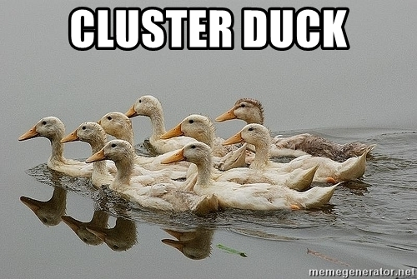

Machine learning
Clustering

Slide 2
Topics
Introduction: GUI and basic calculations
Coding 1: Scripts, style, and variable classes
Coding 2: Control statements and loops
Visualization 1: Basics, subplots, get and set
Coding 3: Functions
Visualization 2: Descriptive plots
Coding 4: Basic input and output
Visualization 3: Distribution and 3D plots
Coding 5: Input and output specials – last lecture before holidays
Machine Learning 1: Introduction and dimension reduction
Machine Learning 2: Clustering
Machine Learning 3: Classification
Coding 6: Efficiency and debugging basics
Coding 7: Advanced functions and debugging

Slide 3
Cluster Analysis
Group a set of data points (each with a number of features) in a way that objects in the same group (cluster) are more similar to each other than those in other groups
Common tool for exploratory data analysis and statistics
Distance in n-D is generally the used measure
Distance in n-D can be defined in various ways, not just euclidean
Another measure can be density
Invented in 1932 (Driver & Kroeber)
Famously used for personality analysis (Cattell, 1943)

Slide 4
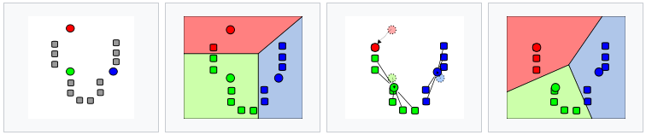
K-Means
A number of clusters (k) are represented by a centroid (artificial data point)
The centroids move around and „collect“ the closest data points
Distance within the cluster (spread) is minimized while distance to other clusters is maximized
Random initialization, iterative approach
Not converging to the same solution all the time!
https://en.wikipedia.org/wiki/K-means_clustering

Slide 5
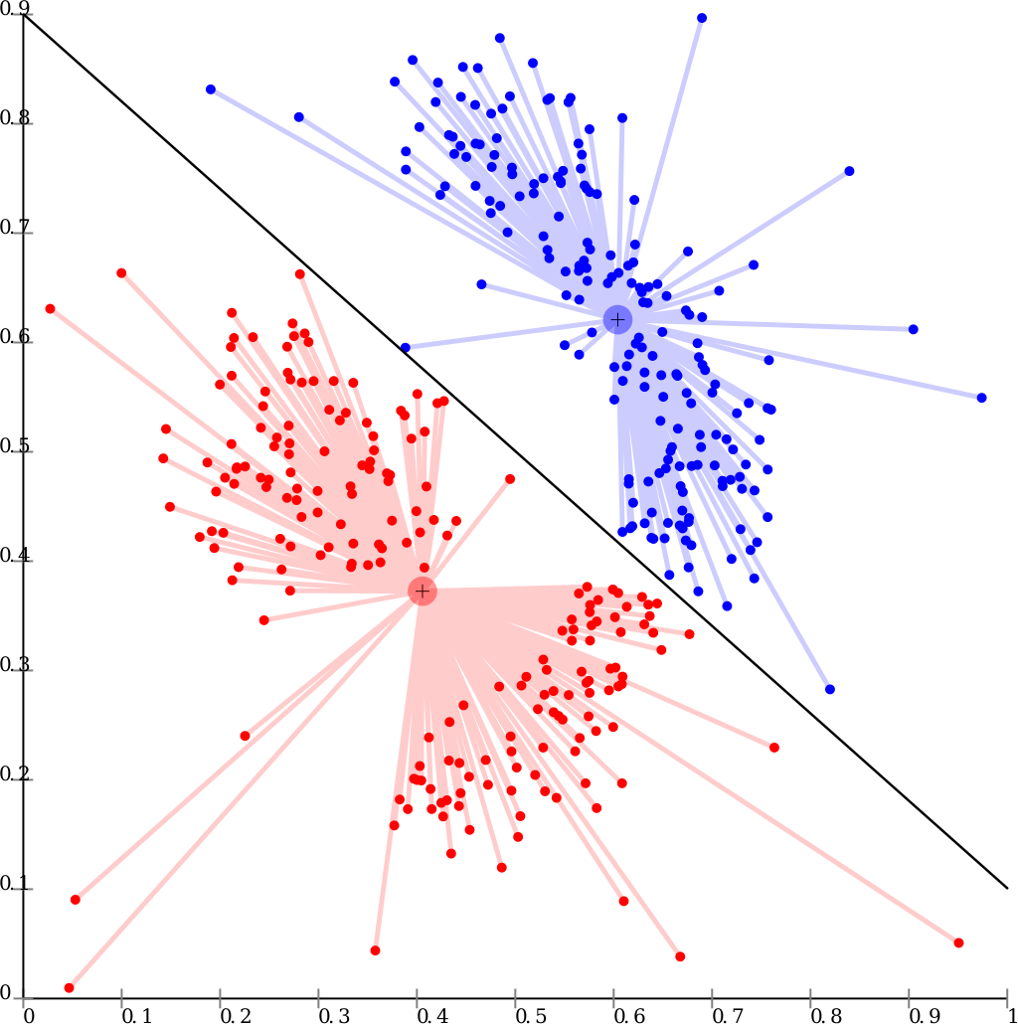
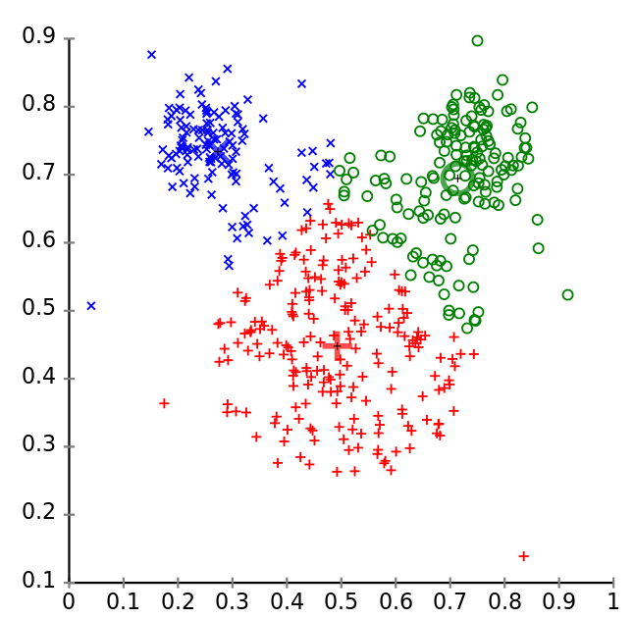
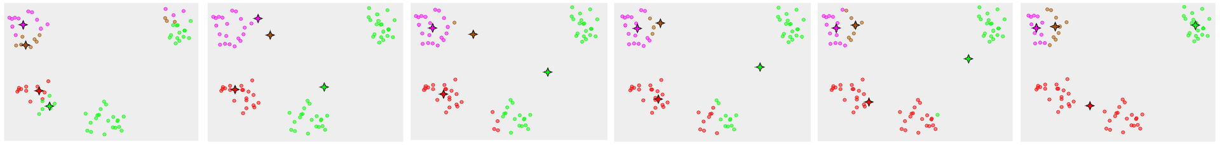
K-Means Limitations
K needs to be specified!
Works well only with spherical distributions
Assumes same-sized clusters
Can run into local minima
https://de.wikipedia.org/wiki/Clusteranalyse
https://en.wikipedia.org/wiki/K-means_clustering
https://en.wikipedia.org/wiki/K-means_clustering

Slide 6
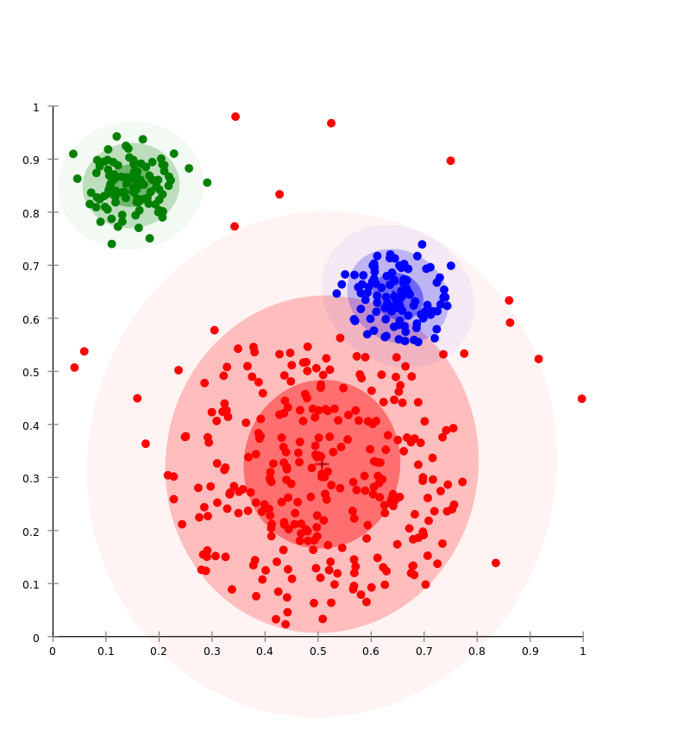
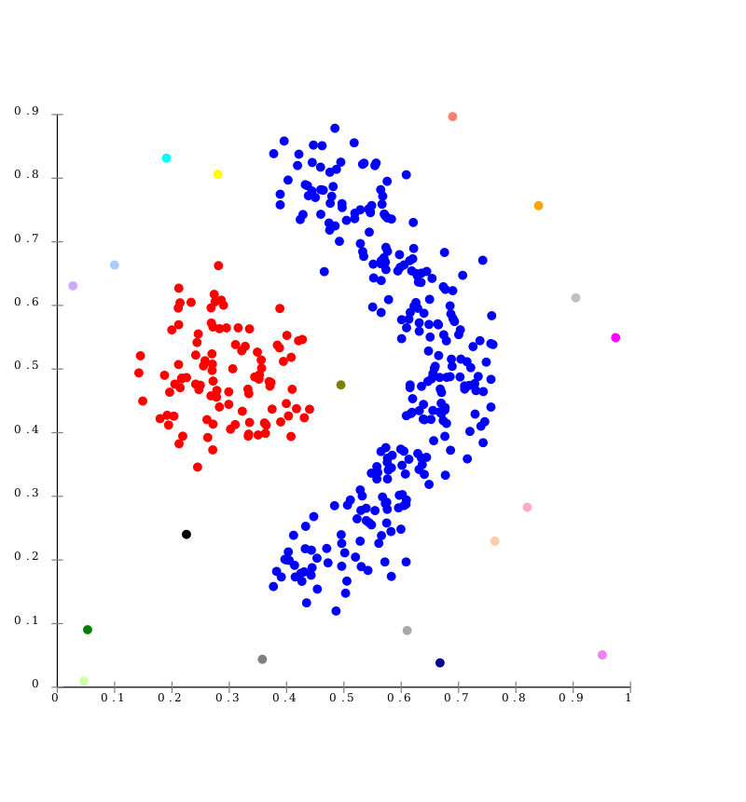
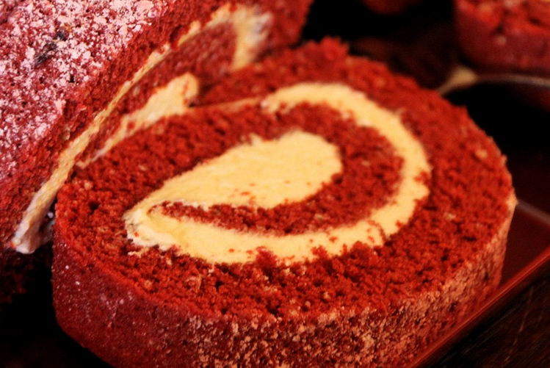
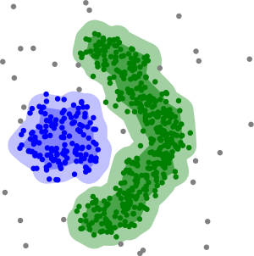
Other Algorithms
Distribution-based
E.g. gaussian mixture models
Connectivity-based
Clusters based on linkage of data points
Nice for swiss roll
Density-based
Arbitrarily shaped clusters of dense regions
Sparse regions are „noise“/border-points
Have problems with overlapping boundaries
-https://en.wikipedia.org/wiki/Swiss_roll
https://de.wikipedia.org/wiki/Clusteranalyse

